Slide 1
Building networks, coalitions and community, sub-national and national action for alcohol control: A case of the Non-Communicable Diseases Alliance in Uganda
By
Shirley Kansabe
Community Outreach Coordinator
Monitoring and Evaluation Officer
Uganda NCD Alliance

Slide 2
Background on UNCDA
UNCDA is a Civil Society Organization (CSO) founded in 2010 by:
  Uganda Cancer Society (UCS)
  Uganda Diabetes Association (UDA)
  Uganda Heart-Research Foundation(UHRF)
We work with other CSOs, government agencies, Development Partners and willing individuals to advance the cause of NCD prevention and control.
We have also established branches in 11 districts in Uganda to extend our work to grass roots.

Slide 3
Background on UNCDA
Concerning networks;
Internationally, we are a member of;
  Global NCD Alliance
  Africa NCD Network
  East Africa NCD Alliance
Nationally, we are an Alliance of three CSOs
  Uganda Cancer Society (UCS)
  Uganda Diabetes Association (UDA)
  Stroke Foundation Uganda (SFU)
Sub nationally,
We work with authorities in 11 districts in Uganda; Arua, Amuria, Gulu, Tororo, Luuka, Nakasongola, Mubende, etc.
At community level,
We support 38 Health Center IIIs and IVs to conduct community sensitization and screening for NCDs and risk factors

Slide 4
Background on NCDs and risk factors in Uganda
NCDs are chronic illnesses that cannot be transferred from one person to another
NCDs are responsible for over 71% of all mortality in the world
They account for 33% of all deaths in Uganda and the chances of dying from one of the four major NCDs is 22%(WHO 2018).
There are four NCDs of global concern (Cardiovascular diseases, cancer, diabetes and chronic respiratory diseases)
There are four major risk factors for NCDs
  Tobacco use
  Unhealthy diets
  Air pollution
  Alcohol use

Slide 5
Alcohol use as a risk factor for NCDs
According to a recent study by World Health Organization (Invisible numbers) 4% of all NCD deaths are due to alcohol use (WHO 2022)
Alcohol use has been implicated in the etiology of over 200 diseases (NCD Alliance 2022)
Alcohol use stands at 26.8% in Uganda according to the 2014 STEPS survey.
Of all alcohol users, 9.8% have an alcohol-related disorder (Kabwama 2016)

Slide 6
Partnerships and coalitions for alcohol control: Raiding on the foundations of UNCDA
Building on the work of the Solidarity Fund for Covid-19

Slide 7
The Solidarity Fund for Covid-19 in Uganda
Project funded by the Global NCD Alliance and implemented by UNCDA between July and December 2021 with the following objectives:
To establish functional groups of People Living with NCDs (PLWNCDs) to engage in NCDs and COVID-19 programs at all levels of response
To engage PLWNCDs and their caregivers at community level to participate in NCD programs and activities.
To provide platforms where views and voices of PLWNCDs inform policy and decisions on NCD programs amidst COVID-19.
The aim was to increase participation of PLWNCDs in decision making at all levels

Slide 8
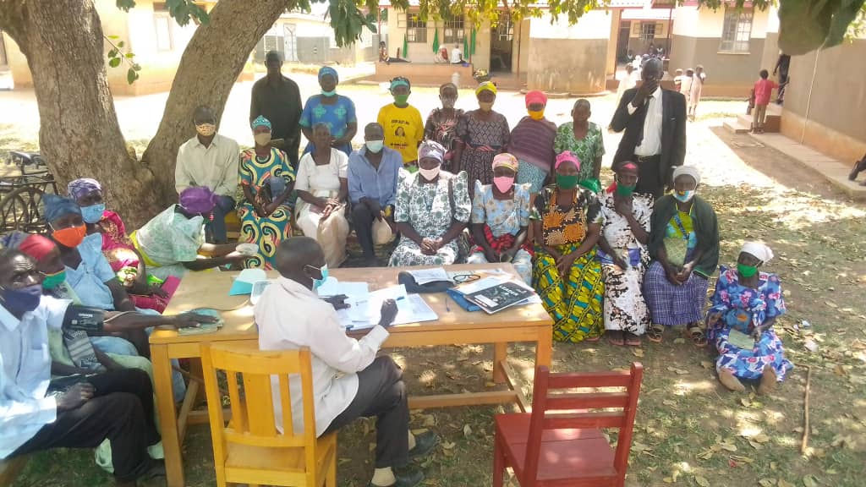
Coalitions, partnerships and network built under the Solidarity fund
A total of 16 groups of PLWNCDs were formed in four districts of Luuka, Serere, Nakasongola and Tororo. They are now pooling resources to supplement government supplies at health facilities and providing peer support.
Their functions are broadening to include advocacy for NCD prevention and control, including for risk factors.
One of the groups of PLWNCDs in Tororo

Slide 9
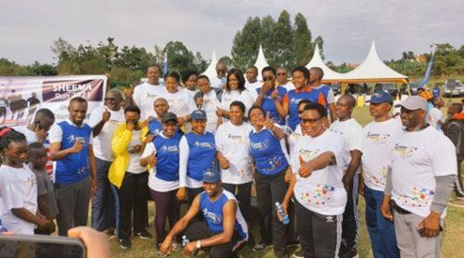
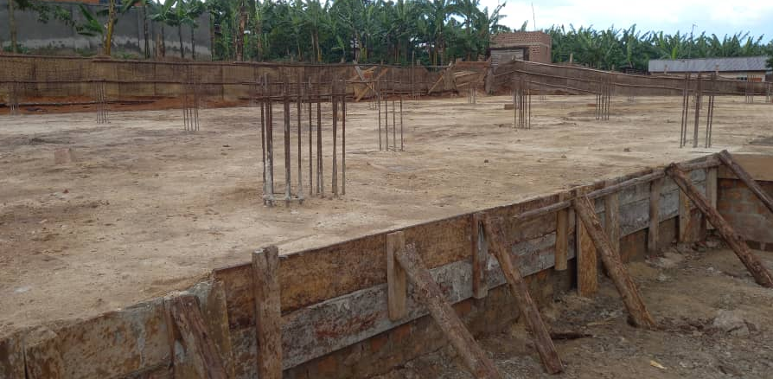
Coalitions, partnerships and network built under the Solidarity fund
At the moment, we have 33 groups of PLWNCDs in 11 districts with a total membership of over 5000 individuals.
The Group in Kabwohe has mobilized for establishment of an NCD complex at Kabwohe Health Center IV in Sheema district.
Members of Parliament that attended the launch of the campaign
NCD complex being constructed at Kabwohe HC IV

Slide 10
Coalitions, partnerships and networks built under the Solidarity fund
These groups are our agents for change in the community
Their experience, agency and passion for NCD control and prevention are untapped assets to drive community action on behavioral NCD risk factors like alcohol use
With the right support and mentorship, groups of PLWNCDs could drive transformational leadership to address NCDs and their risk factors in Uganda
As UNCDA, we call upon all stakeholders to work with us in strengthening our networks for NCD prevention and control

Slide 11
Coalitions, partnerships and network building for NCD control among the youth
We have a new project funded that will work with the youth to build coalitions for NCD prevention and control.
We will apply a more or less similar model of work as for the Solidarity Fund.
Therefore, we are leveraging the strengths of both adults and the youth for NCD prevention and control.

Slide 12
Lessons learnt for building networks for NCD prevention and control
Lessons learned from our work on coalition building are valuable for social mobilization and action on alcohol control most specifically:
Recognizing the need for multi-stakeholder support and input
Identification of willing, passionate, experienced and knowledgeable champions within communities that share your vision.
  Many PLWNCDs are older people, respected in the community and are opinion leaders
Mentorship and support for citizen-led advocacy to drive the desired agenda

Slide 13
Thank you for listening

